Slide 1
Creative Expression as a Healing Force in Medicine
Catherine Justice, DPT, C-IAYT​
Geeta Maker-Clark, MD, ABOIM
Victoria Maizes, MD, ABOIM
Arti Prasad, MD, FACP, ABOIM
Kate Shafto, MD, ABOIM

Slide 2
Workshop format
Brief presentation (5 mins) - Drs. Arti Prasad and Geeta Maker-Clark
Description of small group activity (2 mins each for the 4 presenters - 8 mins)
4 small groups’ self-selection (2 mins)
The small-group facilitation and activity (30 mins).
Small group presentations (4 mins each for 4 groups = 16 mins)
Notes:
Arti

Slide 3
BACKGROUND AND OBJECTIVES
The online Oxford dictionary defines art as “the expression or application of human creative skill and imagination.”
Creativity is essential to art. However, when creativity is not only stifled but also discouraged fervently, art dies.
We, clinicians, and practitioners acknowledge this, and yet seem to have little control over the unfortunate direction our profession is headed in extinguishing the art of it.
Whether it is the art of healing, or healing with arts, we must rekindle this relationship.
Notes:
Arti

Slide 4
The Current State of Burnout in the Medical Profession
Burnout Rates:
50% of physicians experience symptoms of burnout, including emotional exhaustion, depersonalization, and reduced personal accomplishment
Key Stressors:
Long working hours and high patient loads
Administrative burdens and excessive documentation
Emotional toll of patient care and lack of work-life balance
Systemic issues such as understaffing and healthcare inequities
Consequences of Burnout:
Increased risk of medical errors
Higher physician turnover and early retirement
Negative impact on mental health, including depression and anxiety and moral injury
Ortega MV, Hidrue MK, Lehrhoff SR, et al. Patterns in Physician Burnout in a Stable-Linked Cohort. JAMA Netw Open. 2023;6(10)
Notes:
Geeta

Slide 5
The Psychological and Physiological Effects of Burnout
Mental Health Impact:
High levels of chronic stress leading to anxiety and depression
Increased risk of substance use and suicidal ideation among healthcare professionals
Physical Health Consequences:
Elevated cortisol levels linked to heart disease, hypertension, and weakened immune function
Chronic fatigue, sleep disorders, and increased risk of chronic illnesses
Impact on Patient Care:
Reduced empathy and engagement with patients
Higher likelihood of misdiagnosis and procedural errors
Khammissa RAG, Nemutandani S, Feller G, Lemmer J, Feller L. Burnout phenomenon: neurophysiological factors, clinical features, and aspects of management. J Int Med Res. 2022
Notes:
Geeta

Slide 6
Arts and healing in hcw’s
Literature on arts and healing in healthcare includes studies on art therapy, music therapy, and the benefits of creative expression for healthcare workers.
Global research into the use of art therapy-based methods to address burnout and psychosocial distress in HCWs is growing.
These studies show that the arts can help with stress, burnout, and emotional processing.
Findings suggest that art therapy-based methods should be strongly considered as an acceptable and effective treatment for symptoms of emotional exhaustion (burnout) and psychosocial distress in HCWs.
Notes:
Arti - Six databases (PubMed, PsycINFO, MEDLINE, EMBASE, CINAHL, ProQuest Central), Google Scholar and three clinical trial registries (CENTRAL, ICTRP and ClinicalTrials.gov) were searched for studies using art therapy-based methods to engage with burnout risk or psychosocial distress in HCWs
Twenty-seven studies, drawn from thirteen countries, spanning five continents were selected for inclusion. Fifty percent were published in the last five years, indicating growing global research in the field. Fourteen studies used quantitative research methods and thirteen used qualitative methods. A total of 1580 participants took part in the studies, with nurses most broadly represented (59%). Interventions were mostly delivered in groups (95%) and by an art therapist (70%).

Slide 7
The Science of Arts and Healing
Neurological Benefits:
Engaging in creative activities like painting, music, and dance activates the brain’s reward pathways, reducing stress and enhancing mood.
Arts-based interventions have been shown to lower cortisol levels, reduce heart rate, and promote relaxation.
Psychological and Emotional Benefits:
Expressive arts therapy improves emotional regulation and reduces symptoms of PTSD and anxiety.
Music therapy has been shown to enhance cognitive function and alleviate symptoms of depression.
Social and Workplace Benefits:
Art-based activities foster community and connection, reducing isolation among healthcare professionals.
Integrating arts into medical training and hospital environments enhances resilience and job satisfaction.
Stuckey HL, Nobel J. The connection between art, healing, and public health: a review of current literature. Am J Public Health. 2010 Feb;100(2):254-63.
Notes:
Arti

Slide 8
Implementing Arts and Healing in Medicine
Mindful Creativity Practices:
Encouraging medical professionals to engage in art, music, and movement therapy for self-care
Incorporating creative writing, dancing, journaling, and storytelling as stress-reduction tools
Institutional Support:
Developing hospital wellness programs that include music therapy, movement, guided meditation, and visual arts workshops
Advocating for policies that integrate arts into healthcare settings for both practitioners and patients
Future Directions:
More research on long-term benefits of arts-based interventions in reducing burnout
Expanding medical education to include creative expression as a component of well-being and resilience
Notes:
Geeta

Slide 9
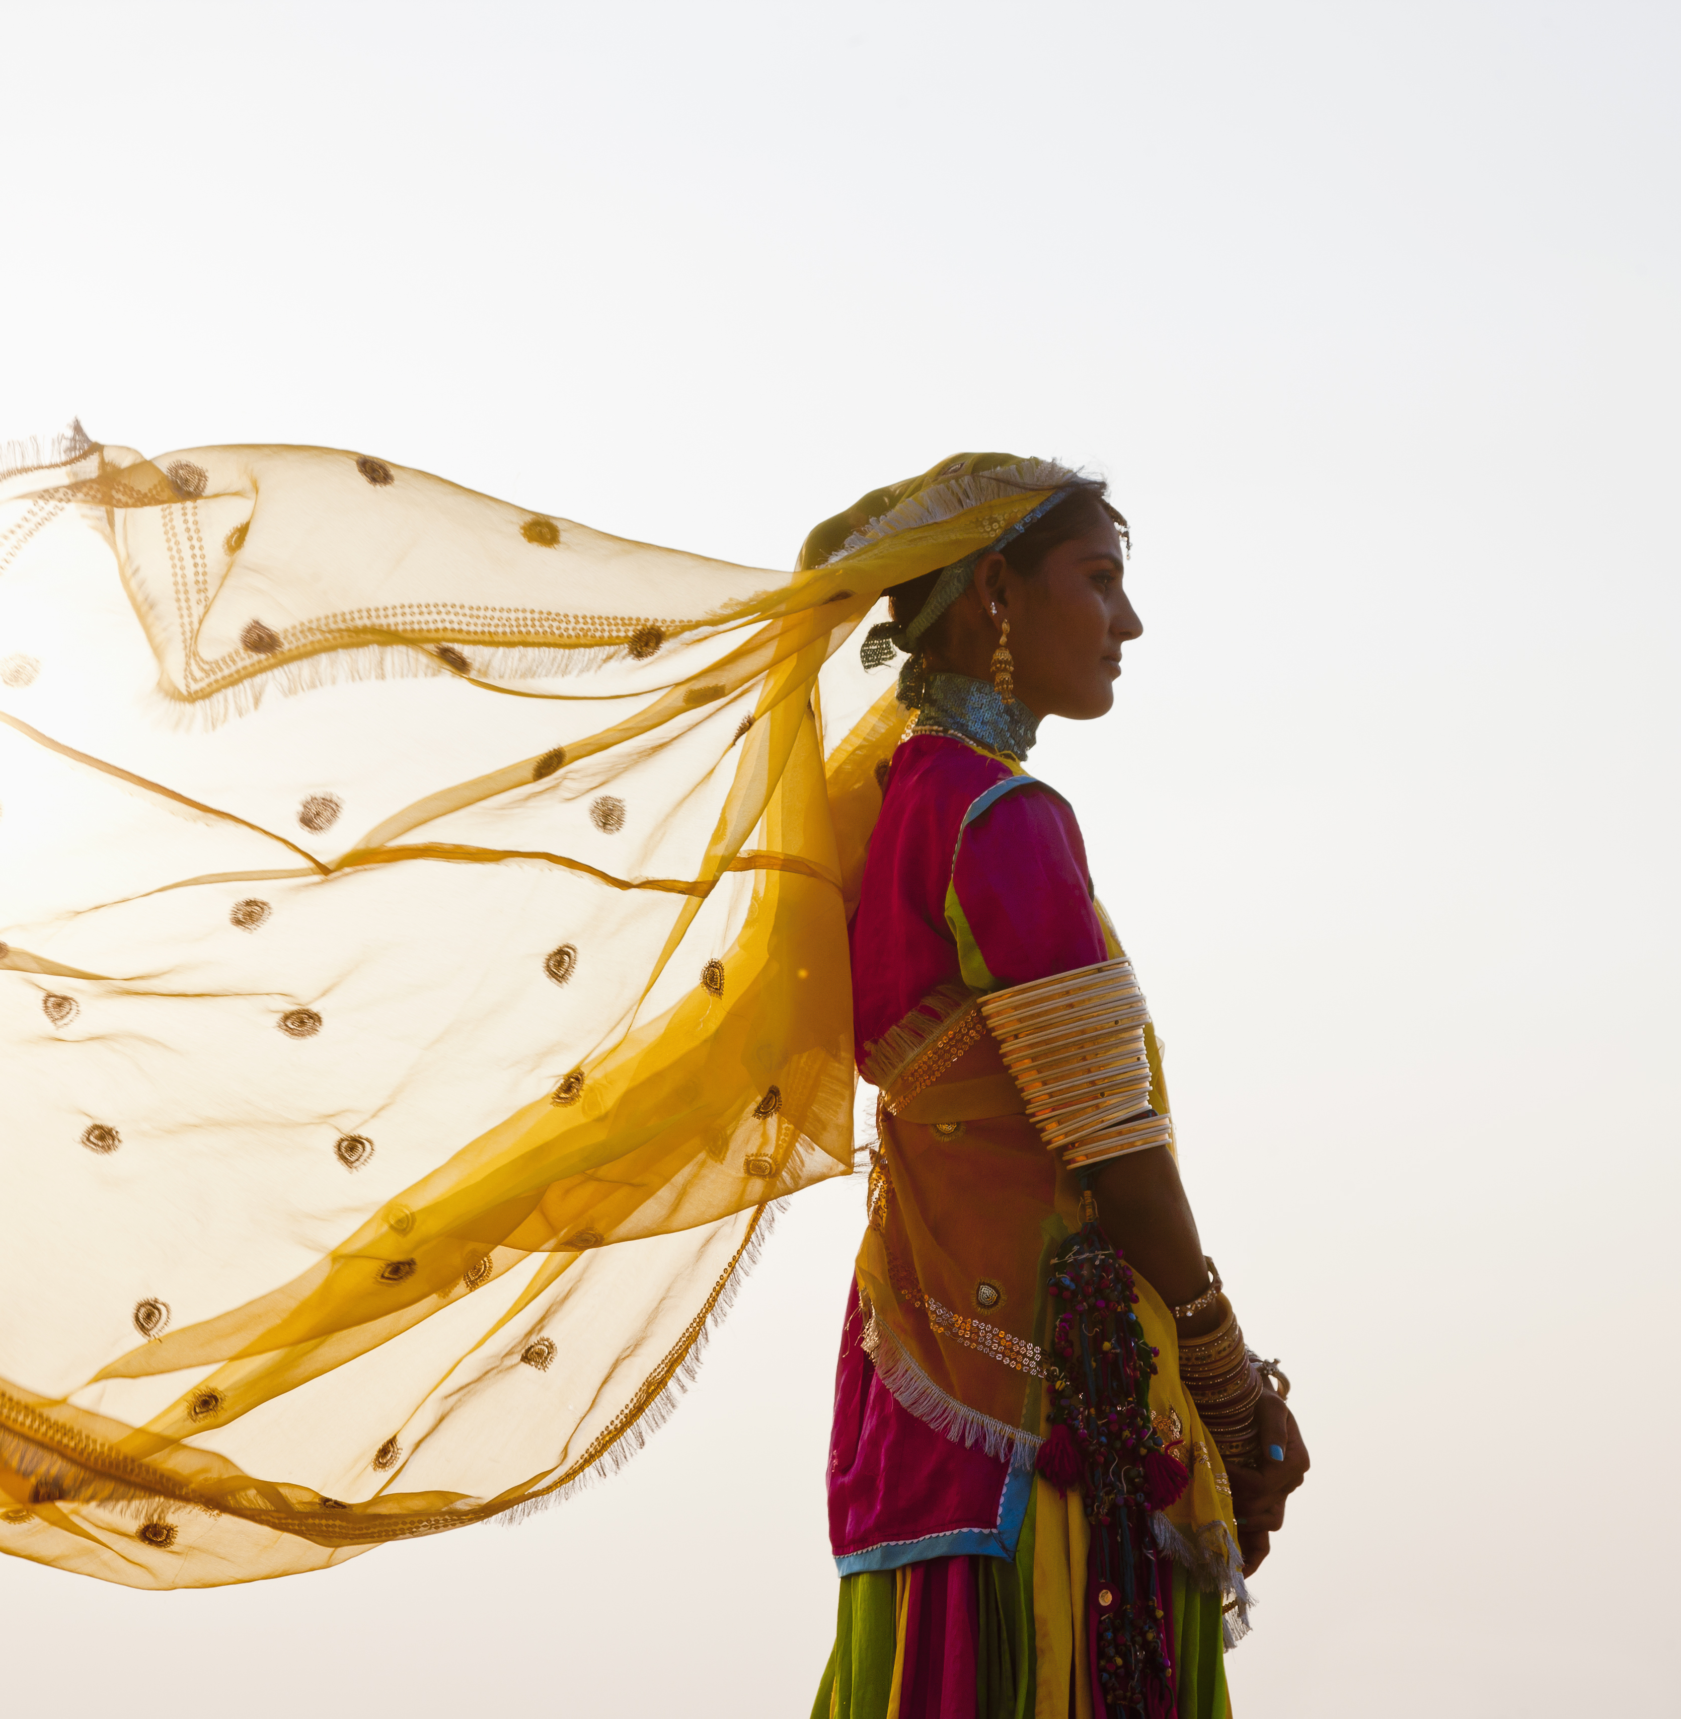
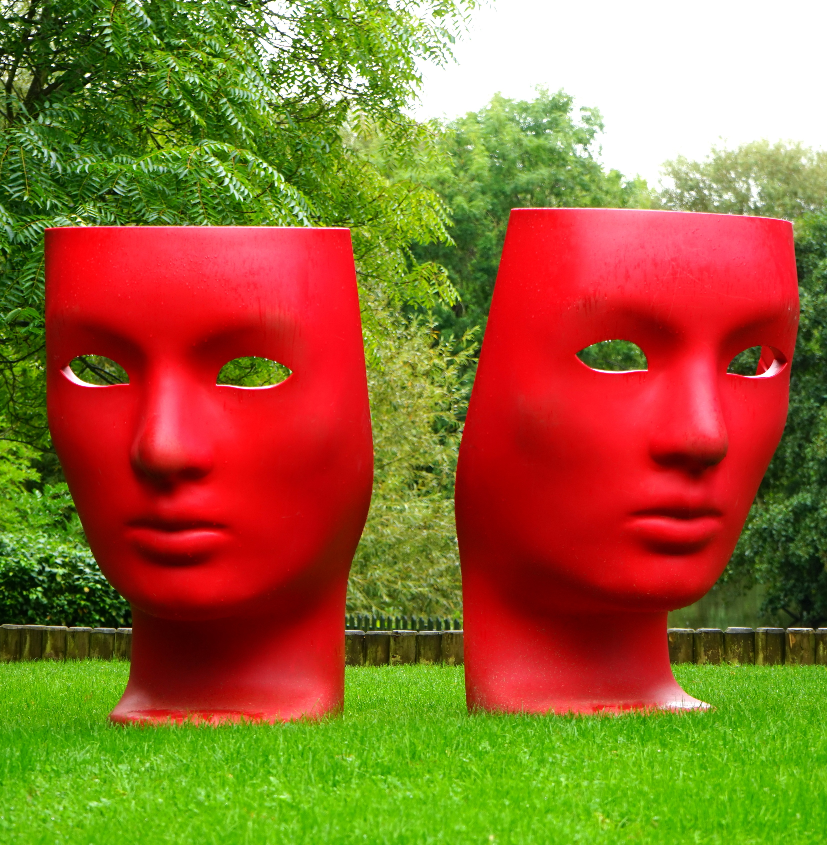
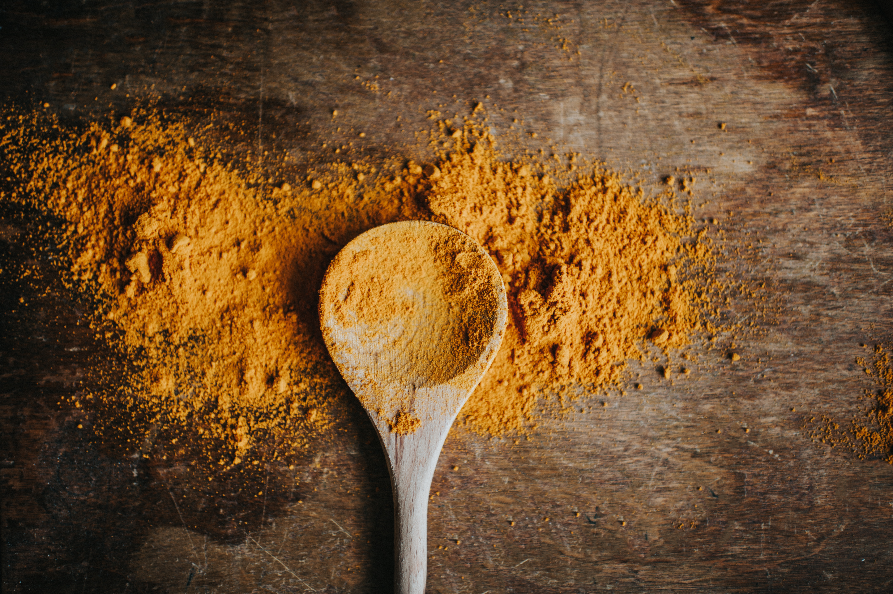
"Art enables us to find ourselves and lose ourselves at the same time."
- Thomas Merton
Notes:
Arti

Slide 10
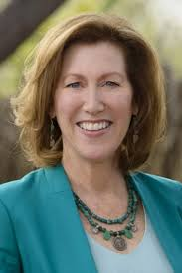
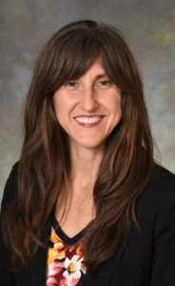
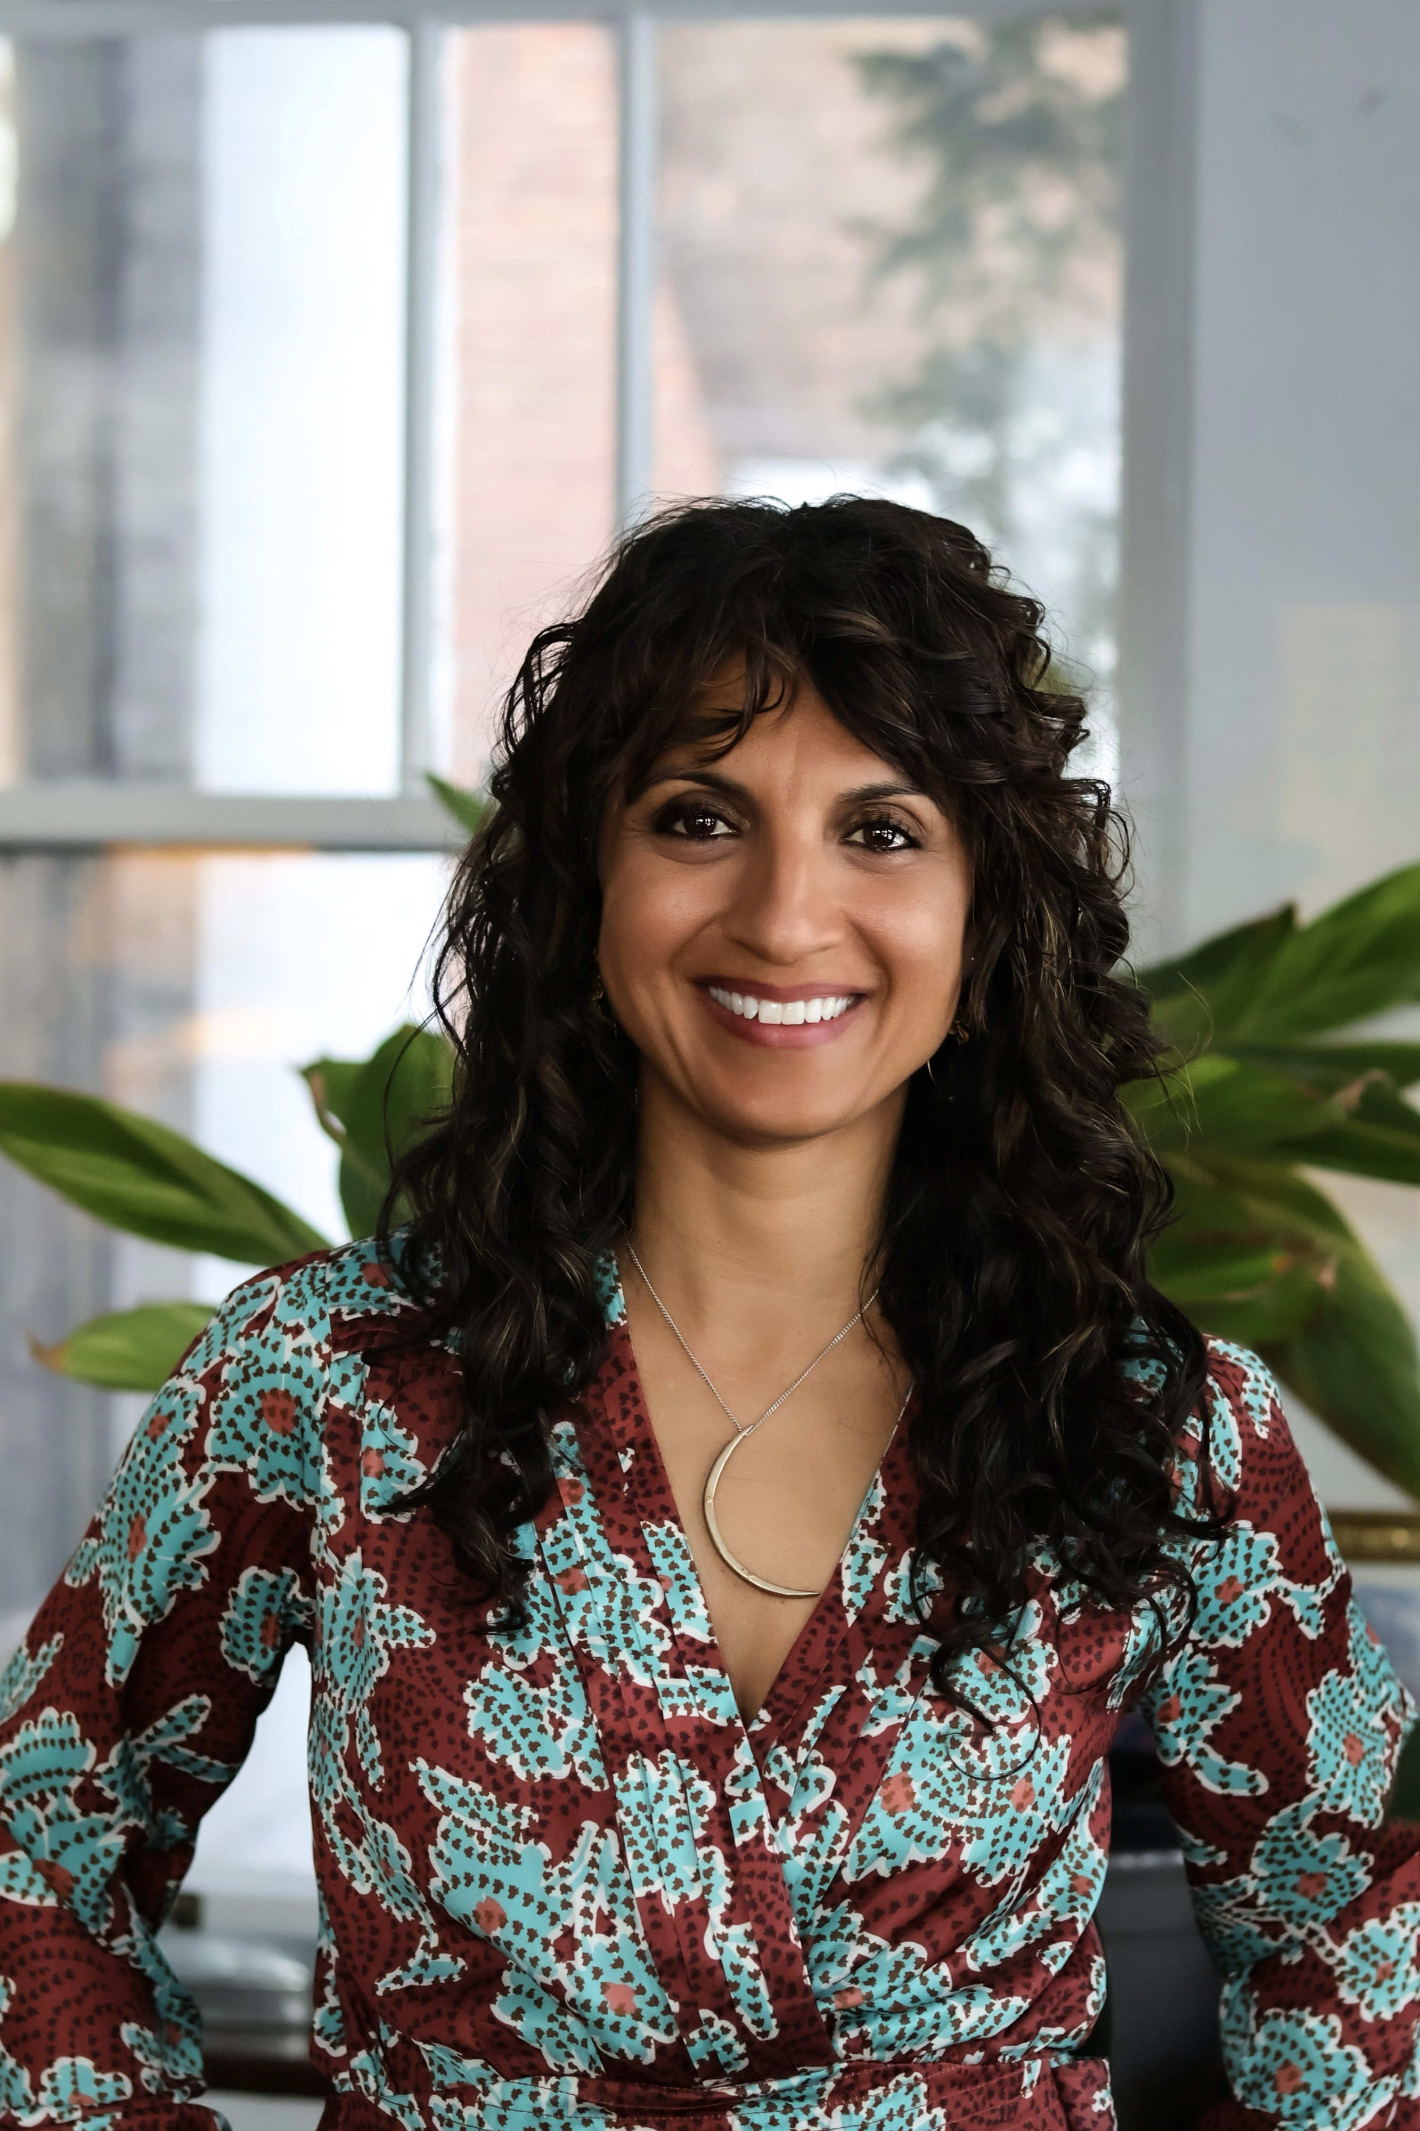
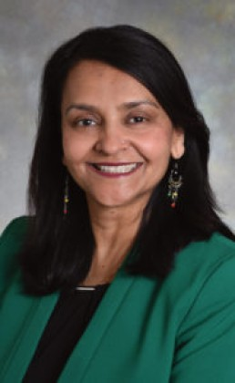
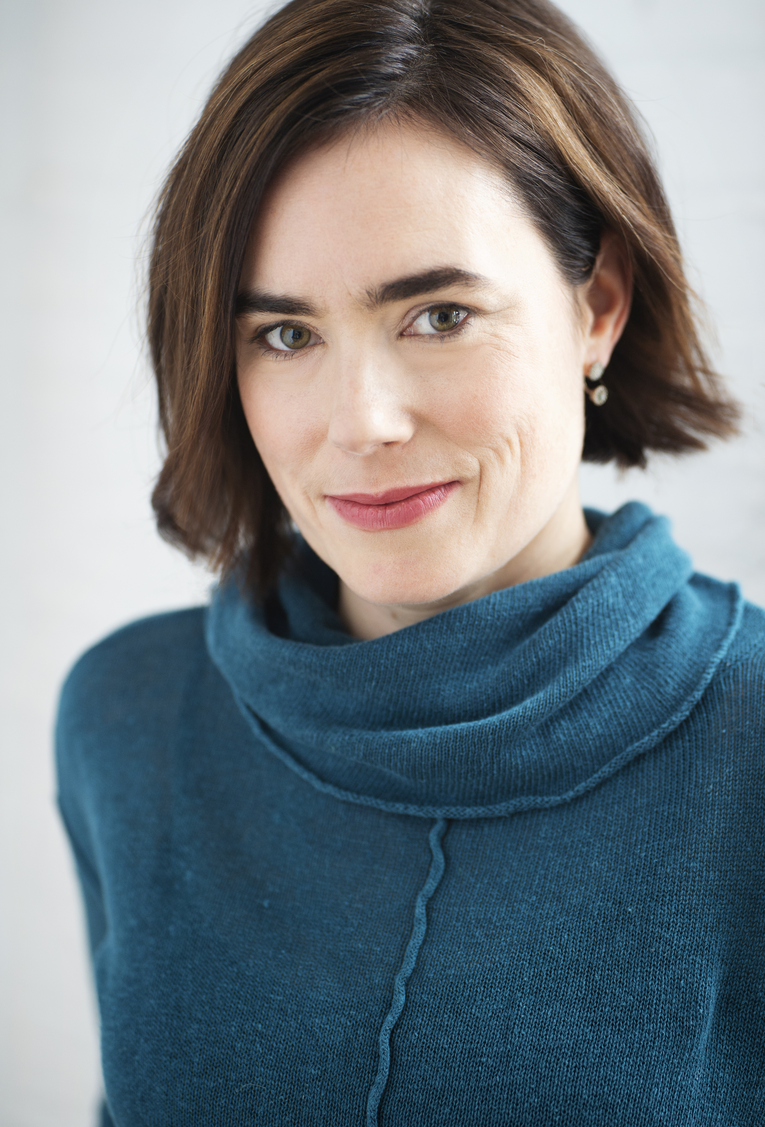
Small group introductions
Creative Writing - Dr. Victoria Maizes
Culinary Arts - Dr. Kate Shafto
Dance - Drs. Geeta Maker-Clark and Arti Prasad
Storytelling through Theater - Dr. Catherine Justice
Notes:
Geeta

Slide 11
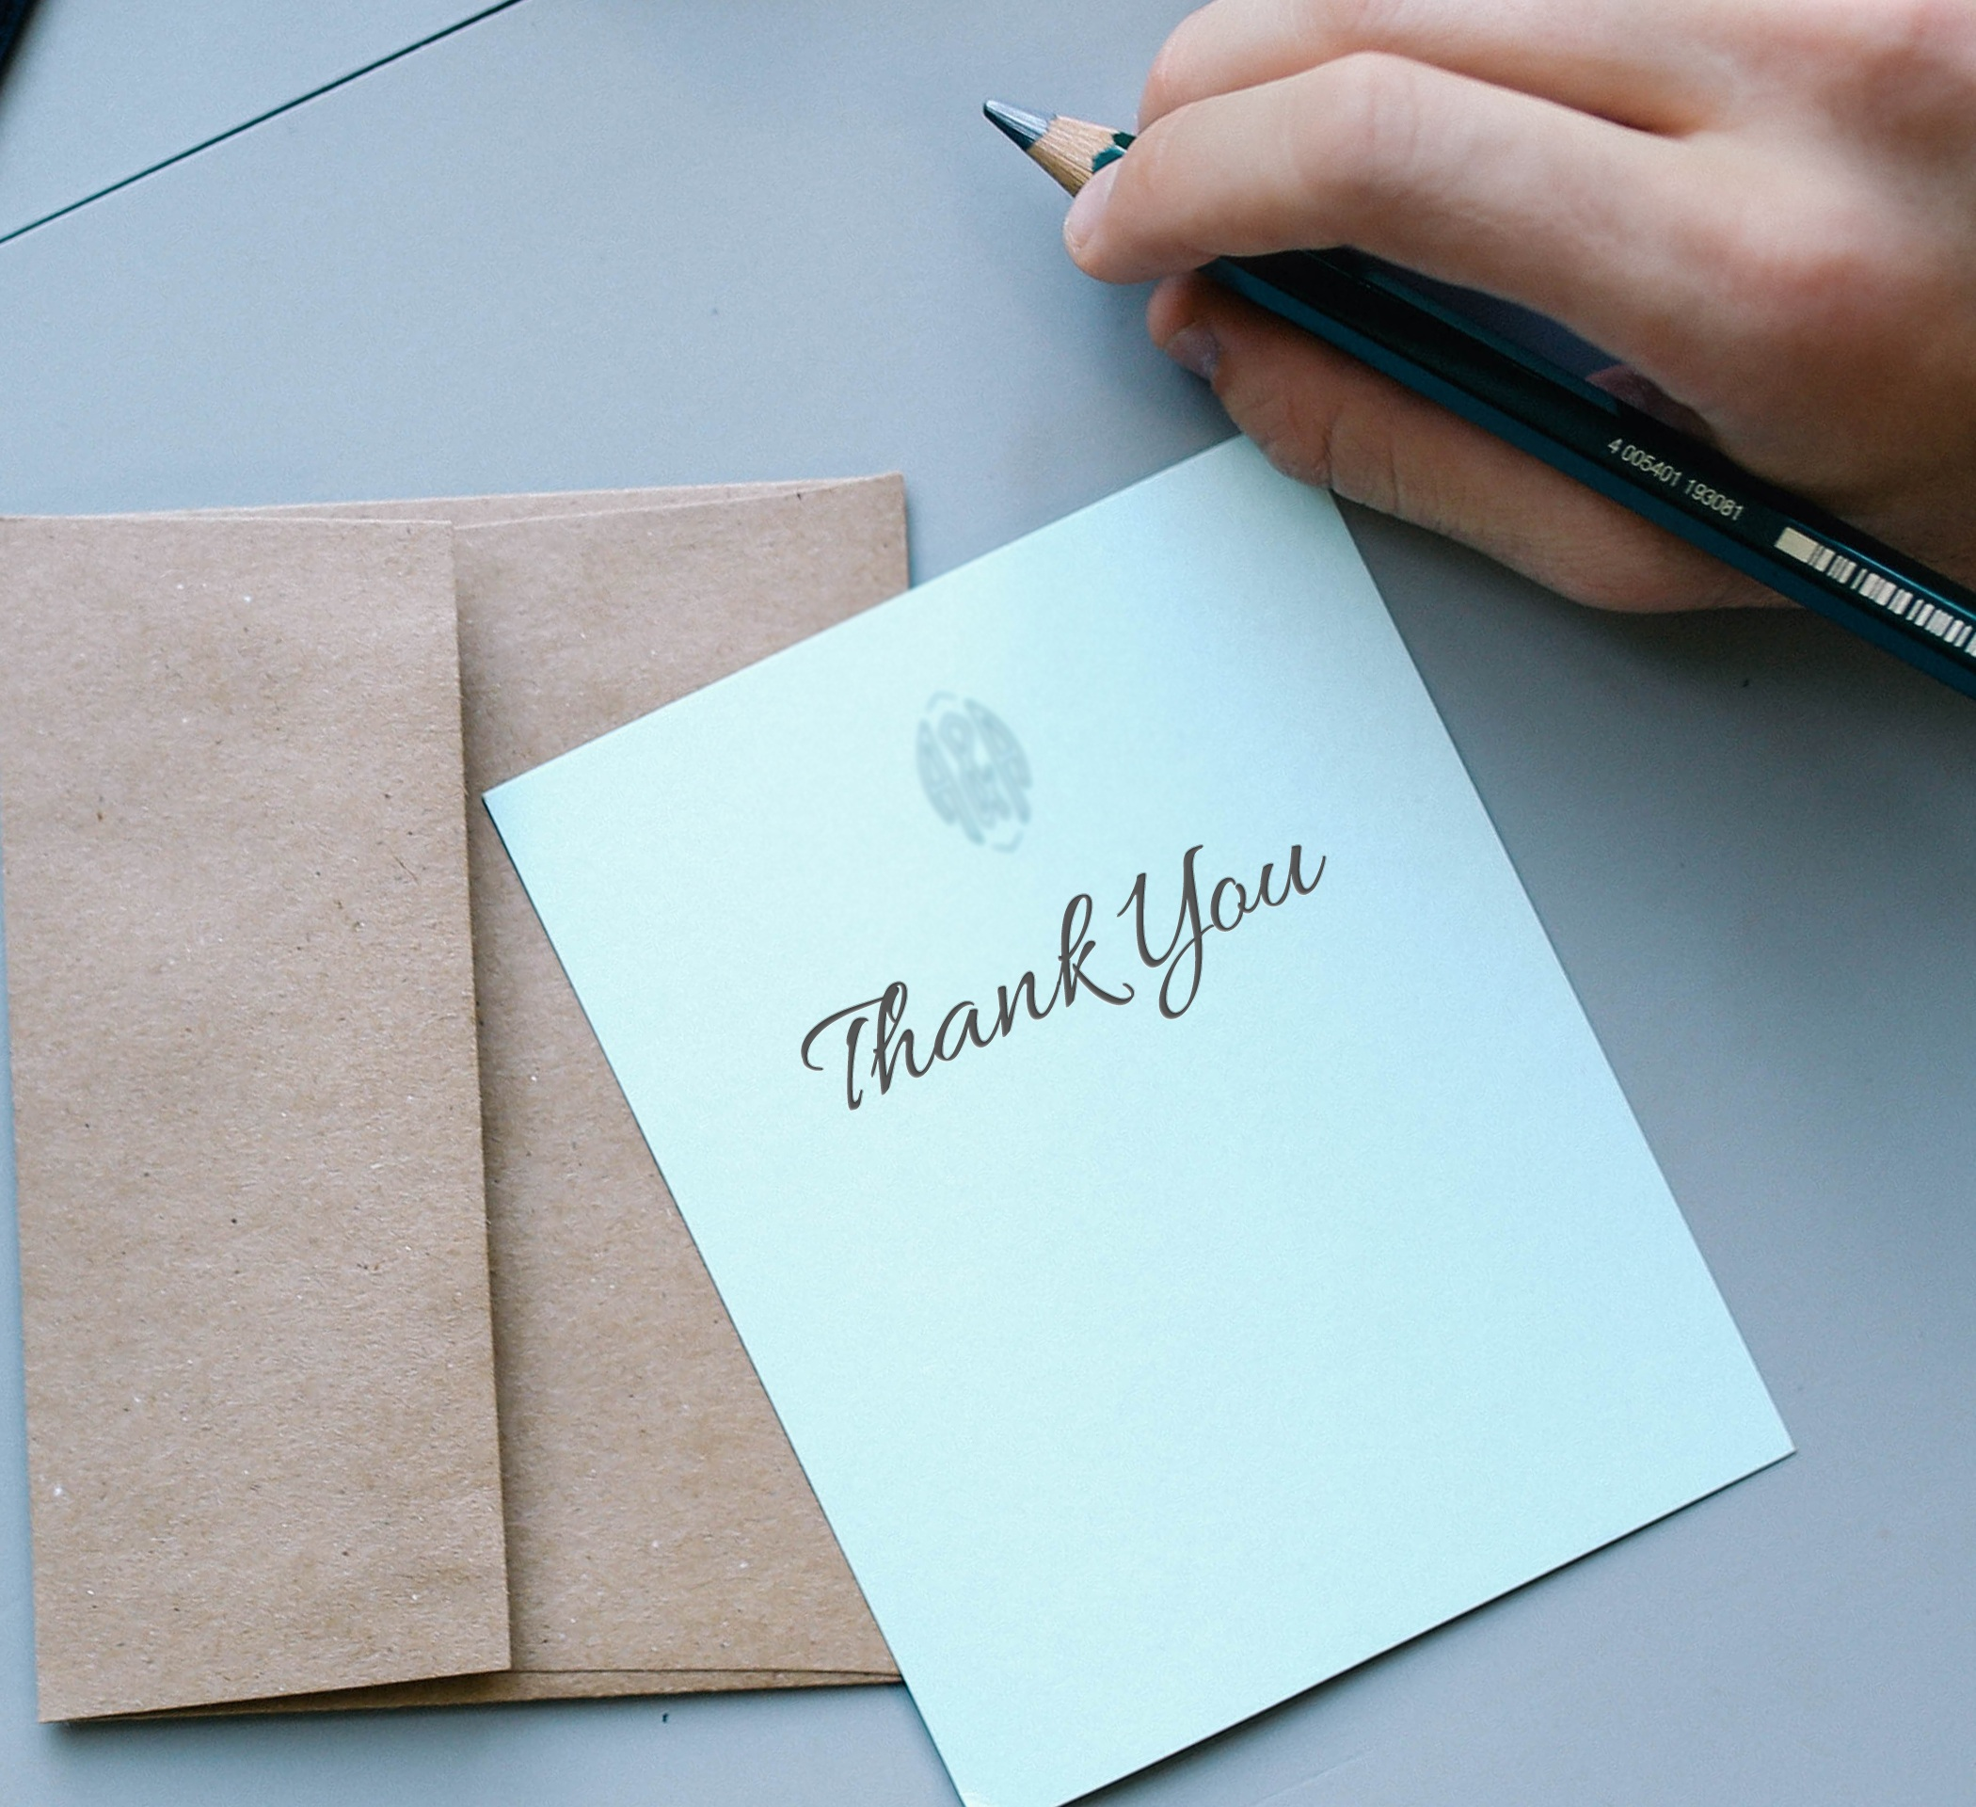
Small Group Reflections and presentations
Notes:
Geeta

